Slide 1


Slide 2
Objective-: Predicting the amount of daily rainfall improves agricultural productivity and secures food and water supply to keep citizens healthy. To predict rainfall, several types of research have been conducted using data mining and machine learning techniques of different countries’ environmental datasets. An erratic rainfall distribution in the country affects the agriculture on which the economy of the country depends on. Wise use of rainfall water should be planned and practiced in the country to minimize the problem of the drought and flood occurred in the country. The main objective of this study is to identify the relevant atmospheric features that cause rainfall and predict the intensity of daily rainfall using machine learning techniques.
Machine Learning Model Used-:
Logistic Regression
Random Forest
XGBoost
KNN
KNN with GridSearchCv

Slide 3
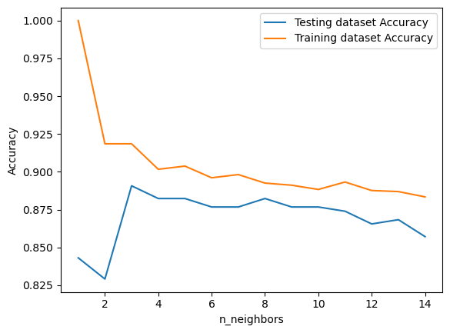
The training accuracy is slightly greater than testing accuracy which may be a symptom of overfitting. Thus we use the k-fold cross validation method as a possible remedy.
Using k-fold cross validation to check for general model accuracy

Slide 4
Results and Findings-:
Can check and improve model performance by trying out multiple Machine Learnings Models.
The K-NN model performs fairly well with an accuracy of 87% using hyperparameter tuning methods.
For the given dataset it can be concluded that the logistic regression model outperforms the K-NN model by a small margin.
Precision Score is 0.91 using XGBoost Model.

